Slide 1

Don't Write Secure Code! a (Build secure systems instead)
Seth Petry-Johnson

Slide 2
I hate writing secure code

Slide 3
I hate writing secure code I hate writing secure feature code

Slide 4
I hate writing secure code I hate writing secure features I hate implementing cross-cutting security concerns by repeating the same patterns over and over again in my feature-level code

Slide 5
What's on the agenda?
Define "cross cutting" security concerns

Slide 6
What's on the agenda?
Define "cross cutting" security concerns
"Secure by default" examples

Slide 7
What's on the agenda?
Define "cross cutting" security concerns
"Secure by default" examples
Declarative vs Imperative security

Slide 8
What's on the agenda?
Define "cross cutting" security concerns
"Secure by default" examples
Declarative vs Imperative security
Audit / Testing

Slide 9
Application "framework"
Any code that leverages "hooks"
in the underlying system

Slide 10
What framework stuff can I tap into?
MVC ActionFilter attributes (OnActionExecuting)
jQuery AJAX events (ajaxStart, ajaxEnd, ajaxPrefilter)
ORM interceptors (connection opened)
PostSharp (property access, method boundaries)

Slide 11
"Cross cutting" concern
Any security requirement that
spans multiple features

Slide 12

"Cross cutting" concerns
Security Requirements:
User must be logged in
Users with the "Manage Orders" permission see all Orders
Everyone else sees only their own Orders

Slide 13
"Cross cutting" concerns
Security Requirements:
User must be logged in
Users with the "Manage Orders" permission see all Orders
Everyone else sees only their own Orders

Slide 14
"Cross cutting" concerns

Slide 15
"Cross cutting" concerns

Slide 16
"Cross cutting" concerns

Slide 17
"Cross cutting" concerns

Slide 18
"Cross cutting" concerns

Slide 19
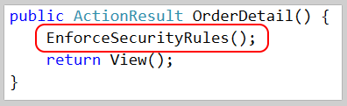
"Cross cutting" concerns

Slide 20
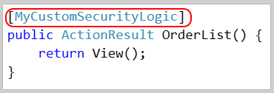
"Cross cutting" concerns

Slide 21

"Cross cutting" concerns

Slide 22
Show me the codez! bit.ly/DontWriteSecureCode

Slide 23
Cross Site Request Forgery Fun fact*: users never log out. Ever.
* Not actually a fact.

Slide 24
Cross Site Request Forgery (CSRF)

Slide 25
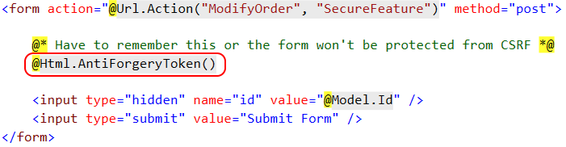
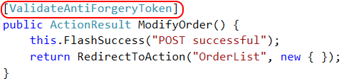
CSRF Defense – feature

Slide 26

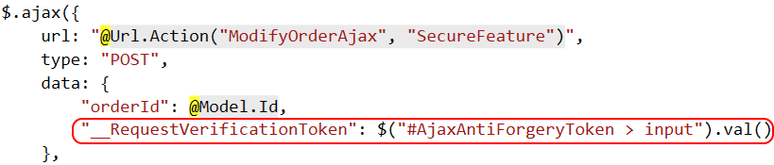
CSRF Defense – feature (ajax)

Slide 27
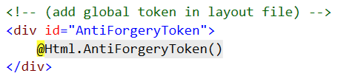
CSRF Defense – cross cutting

Slide 28
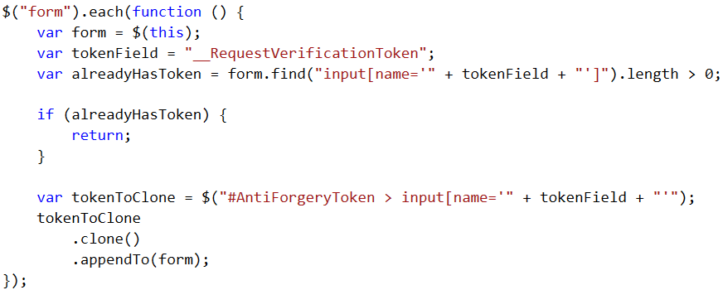
CSRF Defense – cross cutting

Slide 29
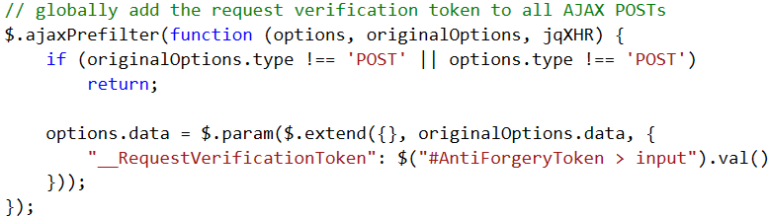
CSRF Defense – cross cutting

Slide 30
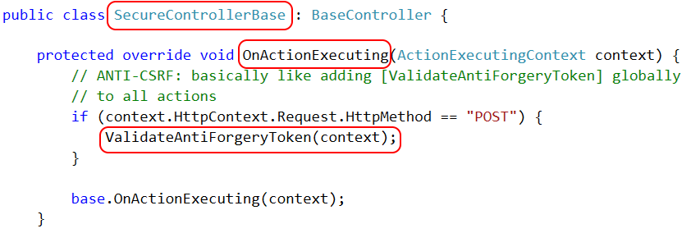
CSRF Defense – cross cutting

Slide 31

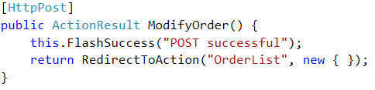
CSRF Defense – cross cutting

Slide 32
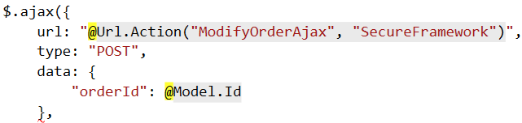
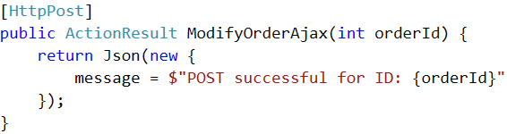
CSRF Defense – cross cutting (ajax)

Slide 33
Authentication Keeping out the unwashed masses

Slide 34
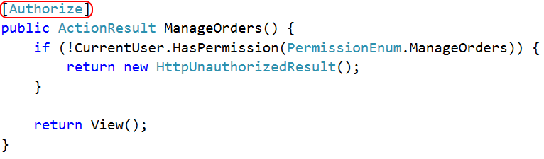
Authentication

Slide 35
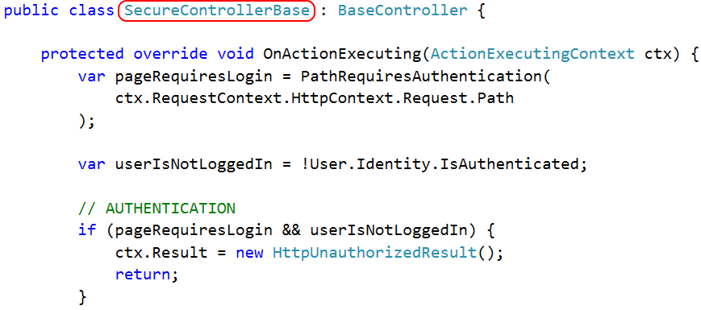
Authentication

Slide 36
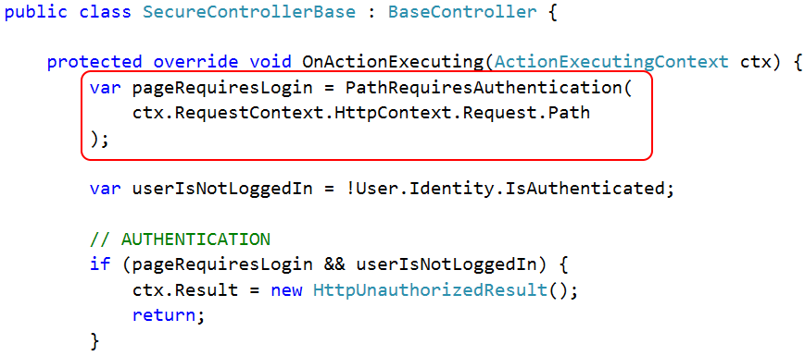
Authentication

Slide 37
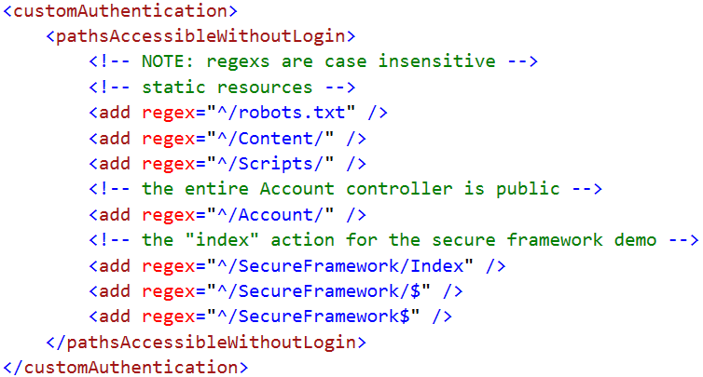
Authentication

Slide 38
Authentication

Slide 39
Access Control Keeping Bob's hands off Alice's data

Slide 40
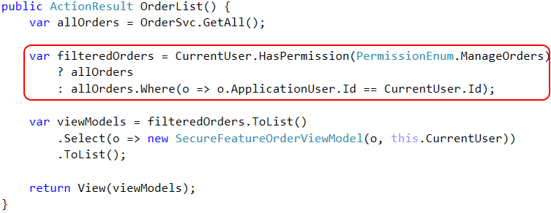
Access Control – feature

Slide 41
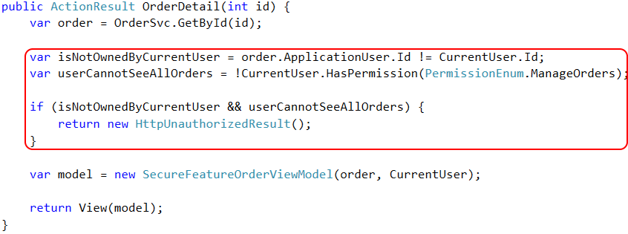
Access Control – feature

Slide 42
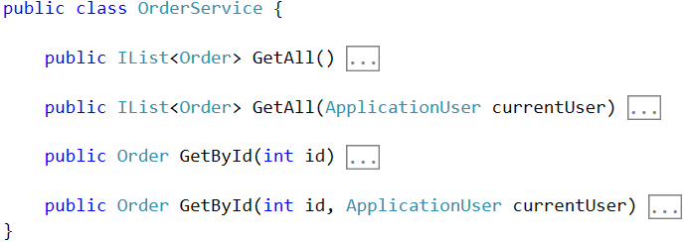
Access Control – framework

Slide 43
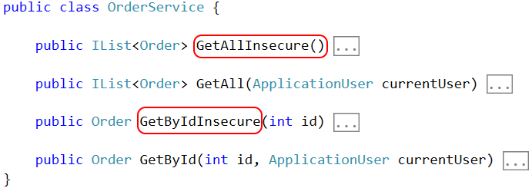
Access Control – framework

Slide 44
Access Control – Row Level Security

Slide 45
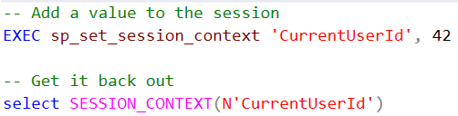

Access Control – Row Level Security

Slide 46
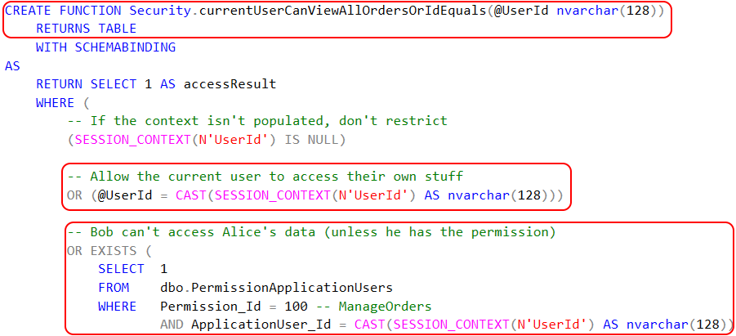
Access Control – Row Level Security

Slide 47

Access Control – Row Level Security

Slide 48
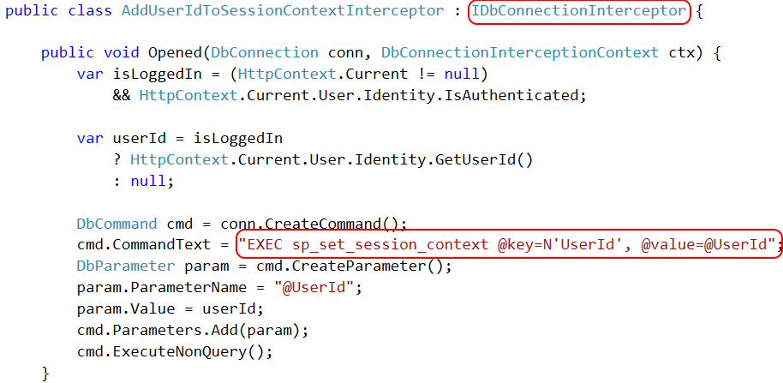
Access Control – Row Level Security

Slide 49
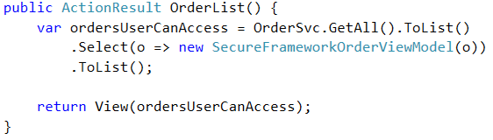
Access Control – framework

Slide 50
Page-level Authorization Keeping Bob in his sandbox

Slide 51
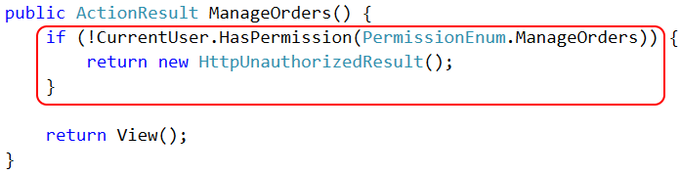
Page Authorization – feature

Slide 52
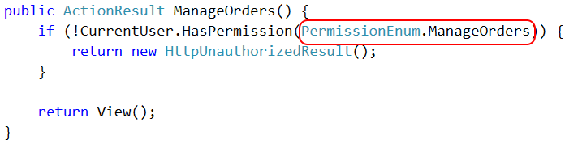
Page Authorization – feature

Slide 53

Page Authorization – cross cutting

Slide 54
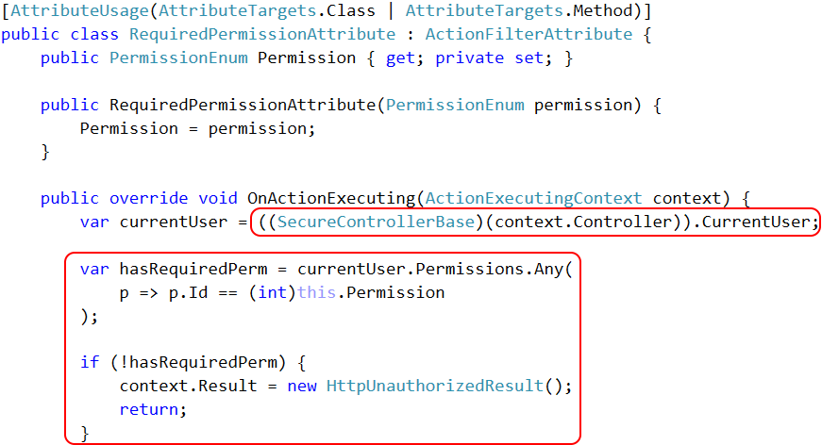

Slide 55
Property-level Authorization Keeping private data private!

Slide 56
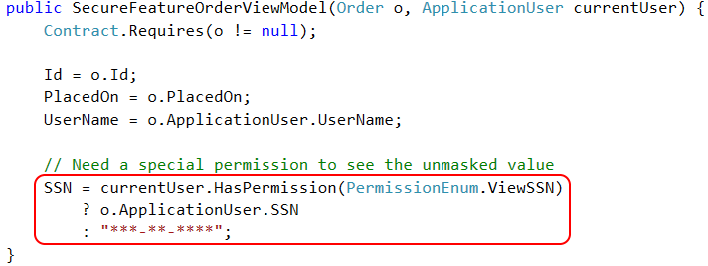
Property Authorization – feature

Slide 57
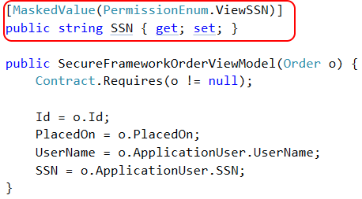
Property Authorization – cross cutting

Slide 58
Property Authorization – cross cutting

Slide 59
Property Authorization – cross cutting

Slide 60
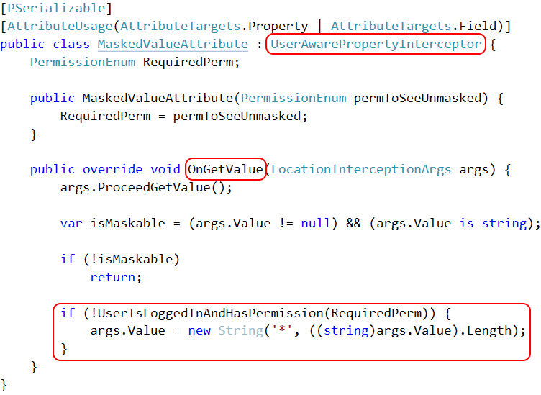

Slide 61
Property Authorization – cross cutting

Slide 62
Auditing and Testing Try this with your fancy dynamic language!

Slide 63
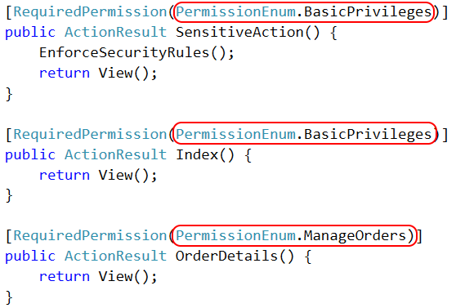
Authorization auditing

Slide 64
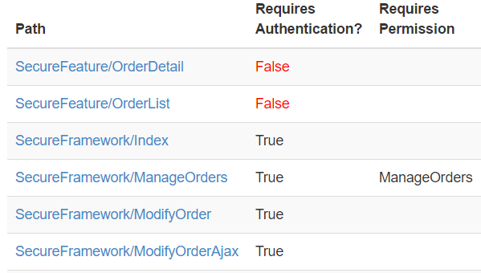
Authorization auditing

Slide 65
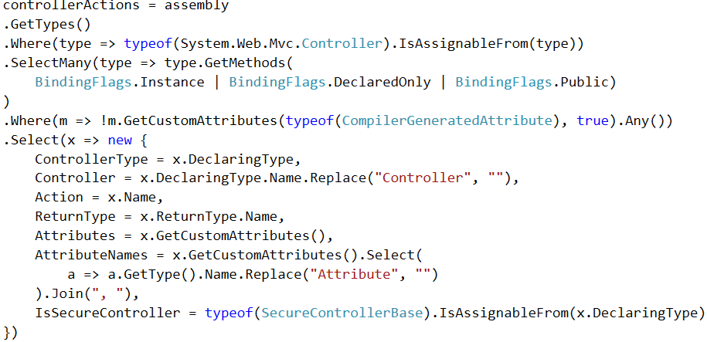
Authorization auditing

Slide 66
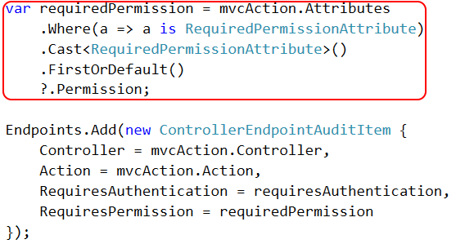
Authorization auditing

Slide 67
Authorization auditing

Slide 68

http://approvaltests.com

Slide 69
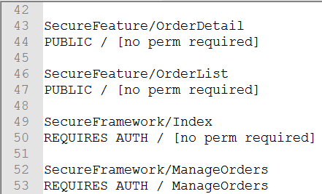
Approval Tests – Step 1

Slide 70
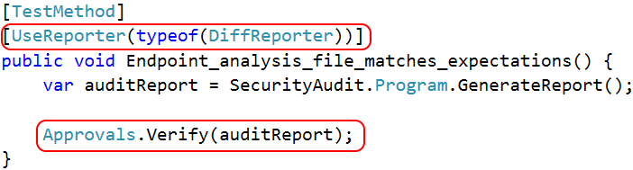
Approval Tests – Step 2

Slide 71
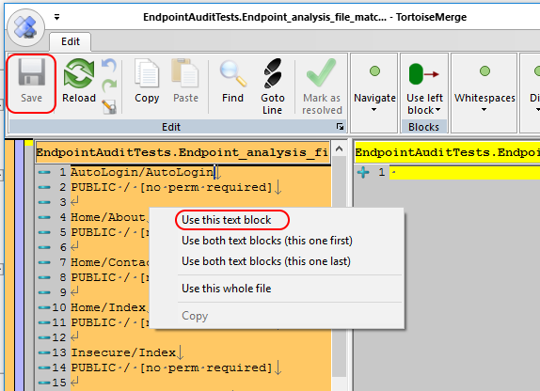
Approval Tests – Step 3

Slide 72
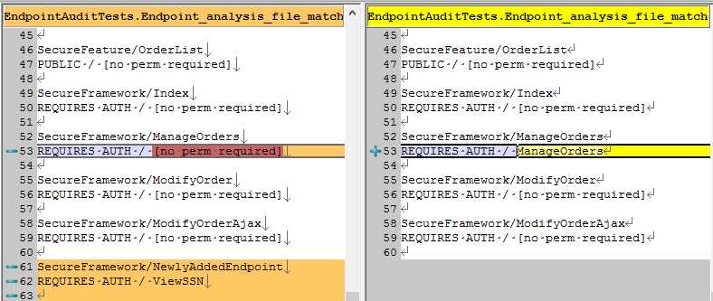
Approval Tests – Step 4

Slide 73
What makes auditing easier?
Using [Attributes] to decorate classes/methods
Inheriting a base class
Implementing an interface

Slide 74
Recap The CliffsNotes version

Slide 75
bit.ly/DontWriteSecureCode
Global CSRF defense
Private-by-default MVC controllers
Row level security in SQL Server 2016
Permission-based MVC attributes
Permission-based property access, with PostSharp
Auditing w/ reflection and Approval Tests
github.com/spetryjohnson | www.petry-johnson.com
@spetryjohnson

